Slide 1
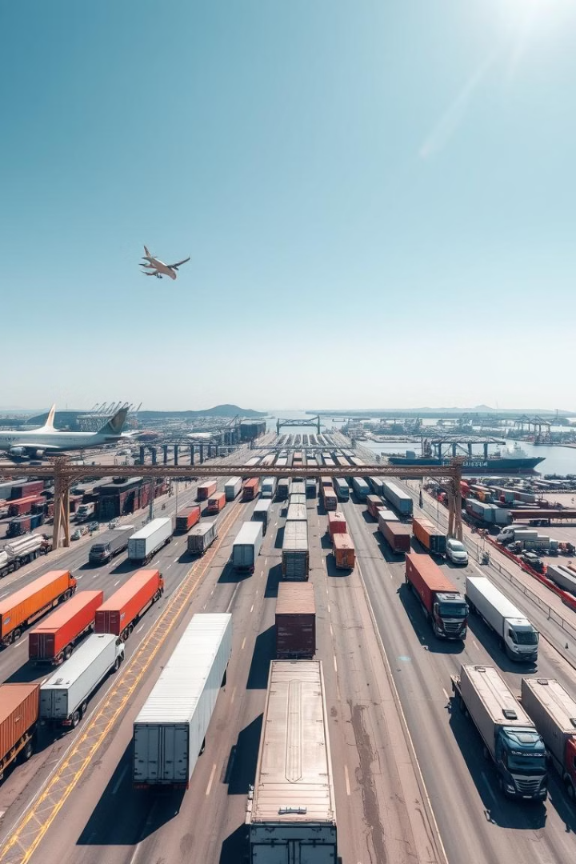

Transborder Freight Data Analysis
This presentation analyzes transborder freight transportation between the U.S., Canada, and Mexico. It identifies inefficiencies, optimizes transportation modes, and enhances the sustainability of freight operations. The analysis uses data-driven insights to address key questions about freight movement patterns, congestion, environmental impact, and freight charges.
The study aims to provide actionable recommendations for improving the efficiency and sustainability of the transborder freight industry, contributing to North America's economic growth and environmental stewardship.
by Samuel Ayim

Slide 2

Key Research Questions
1
Freight Volume Trends
What are the trends in freight volume across different transportation modes?
2
Highest Freight Value
Which U.S. states and Canadian provinces handle the highest freight value?
3
Freight Charges Comparison
How do freight charges compare between import and export shipments?
4
Environmental Impact
What is the environmental impact of different transportation modes in terms of emissions?

Slide 3
Hypothesis Formulation
Road Transport
Top Freight States
Import Charges
Road transportation has the highest freight volume and congestion compared to other modes.
The U.S. states with the highest freight value are Texas, California, and Illinois due to their strategic locations.
Import freight charges are higher than export freight charges due to tariffs, customs, and supply chain bottlenecks.

Slide 4
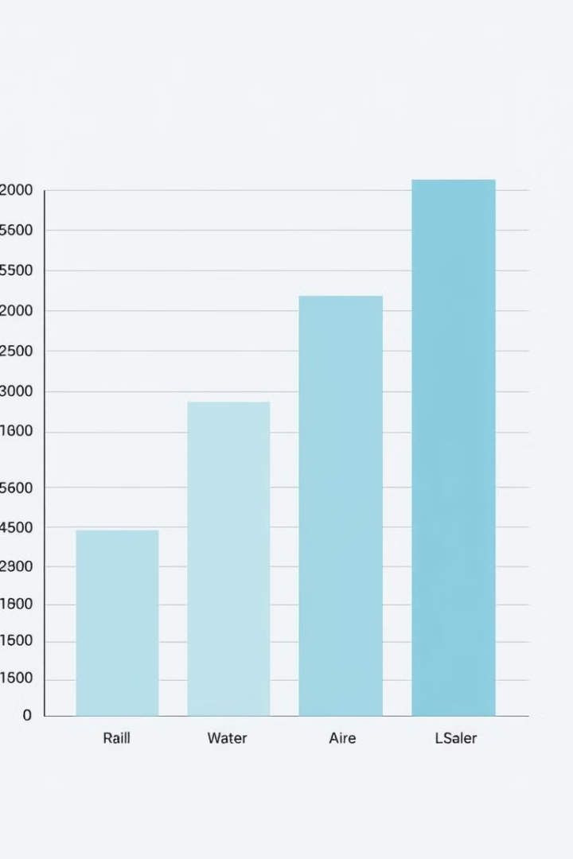
Freight Volume by Transportation Mode
Road transport accounts for the largest share of transborder freight movement, contributing over 65% of total shipments. Rail transport follows, handling around 20% of total freight volume. Air transport, despite its high cost, is primarily used for high-value shipments but contributes less than 5%. Water transport has the lowest volume but is highly efficient for bulk shipping.
Road Transport
Rail Transport
65% of total shipments
20% of total freight volume
Air Transport
Less than 5% of total volume

Slide 5



Top U.S. States by Freight Value
The top three U.S. states with the highest freight value are Texas, Michigan and California, which aligns with expectations due to their major logistics hubs. Other high-volume states include Illinois, New York, and Ohio, benefiting from cross-border trade with Canada. Illinois holds the highest shipment value, indicating its critical role in U.S. supply chains.
Texas
Michigan
California
Key trade hub
Automotive trade
Major ports

Slide 6




Environmental Impact by Mode of Transport
Air transport emits the highest CO₂ per ton-mile, making it the least sustainable. Rail and water transport have the lowest emissions, making them the most environmentally friendly. Truck transport contributes the most total emissions, as it is the most used mode. Transitioning 10% of road freight to rail could reduce CO₂ emissions by up to 30%.
Air Transport
Truck Transport
Rail/Water Transport
Highest CO₂ emissions
Most total emissions
Lowest emissions

Slide 7

Conclusions
Road transport remains dominant but contributes the most to congestion and emissions. Strategic states such as Illinois, Texas, and California are key freight hubs, requiring continued investment in logistics infrastructure. Import freight charges exceed export charges, emphasizing the need for supply chain optimization. Rail and water transport should be further leveraged for sustainability improvements. Seasonal peaks indicate the need for adaptive freight management strategies to prevent congestion and inefficiencies.
1
Road Transport
Dominant, but causes congestion
2
Key Freight Hubs
IL, TX, CA need investment
3
Import Charges
Need supply chain optimization

Slide 8
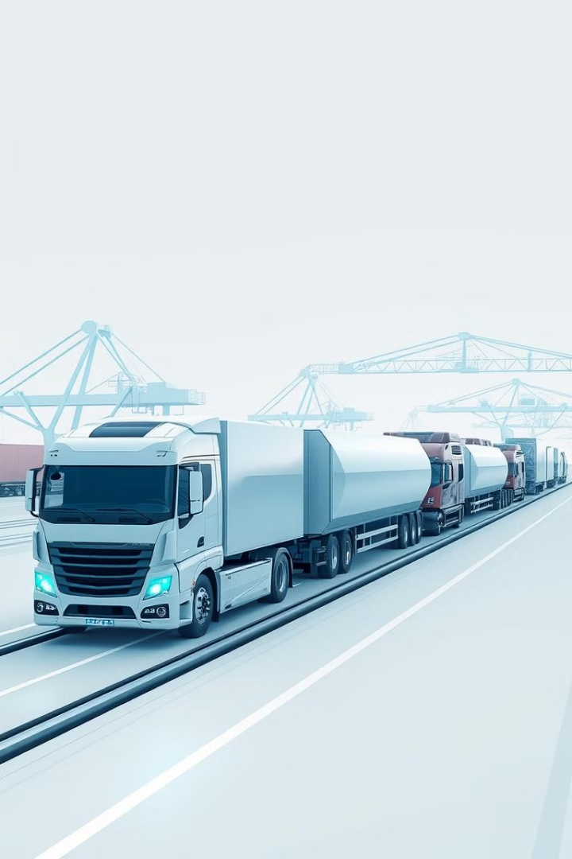
Recommendations
Invest in rail and water transport: Expanding intermodal logistics hubs can shift freight from congested highways to more sustainable options. Optimize import supply chains: Negotiating bulk shipping discounts and reducing customs bottlenecks can lower import costs. Enhance infrastructure in top freight states: Increasing warehouse capacity and logistics automation in Illinois, Texas, and California can improve efficiency. Adopt low-emission trucking fleets: Electrification and alternative fuels for road transport can mitigate environmental impacts. Improve seasonal logistics planning: Implementing predictive analytics can help freight companies prepare for peak seasons more effectively.
Invest in Rail/Water
Expand intermodal hubs
Optimize Imports
Reduce customs bottlenecks
Enhance Infrastructure
Increase warehouse capacity

